Slide 1

National Forum on Youth Violence Prevention
April 2 & 3, 2012
177 Square miles
1,000,000 + people
10th largest U.S. city
4th Safest U.S. city with population over 500,000
2-23-12
Notes:
National Forum on Youth Violence Prevention
April 2 & 3, 2012
177 Square miles
1,000,000 + people
10th largest U.S. city
4th Safest U.S. city with population over 500,000

Slide 2

Mayor’s Gang Prevention Task Force History
Mayor’s Gang Prevention Task Force History
1990: Stopping the violence
2000: Reclaiming our youth - Building the full continuum of service: Prevention, Intervention and Suppression
2007-Present: Transforming our youth through Results Proven Programs
Notes:
Mayor’s Gang Prevention Task Force History
1990: Stopping the violence
2000: Reclaiming our youth - Building the full continuum of service: Prevention, Intervention and Suppression
2007-Present: Transforming our youth through Results Proven Programs
2

Slide 3
Continual Improvement
Continual Improvement
Working Subcommittees
Inter-agency Collaborative
- Re-Entry Network
- Alternative Schools
Community Engagement
- Crime and Gang Prevention Summit
- Faith Initiative
Technical Team
City/School Collaborative
Notes:
Continual Improvement
Working Subcommittees
Interagency Collaborative
Re-Entry Network
Alternative Schools
Community Engagement
Crime and Gang Prevention Summit
Faith Initiative
Technical Team
City/School Collaborative
3

Slide 4
Current Efforts & Focus
We must work in closer partnership with our faith community.
Gangs do not respect city, county or state boundaries, we must work locally, regionally and nationally to address the issue holistically.
The city and county needs to work together to reduce the recidivism rate of those coming out of the prison system. 60% of released inmates are San Jose residents.
Notes:
Current Efforts & Focus
We must work in closer partnership with our faith community.
Gangs do not respect city, county or state boundaries, we must work locally, regionally and nationally to address the issue holistically.
The city and county needs to work together to reduce the recidivism rate of those coming out of the prison system. 60% of released inmates are San Jose residents.
4

Slide 5
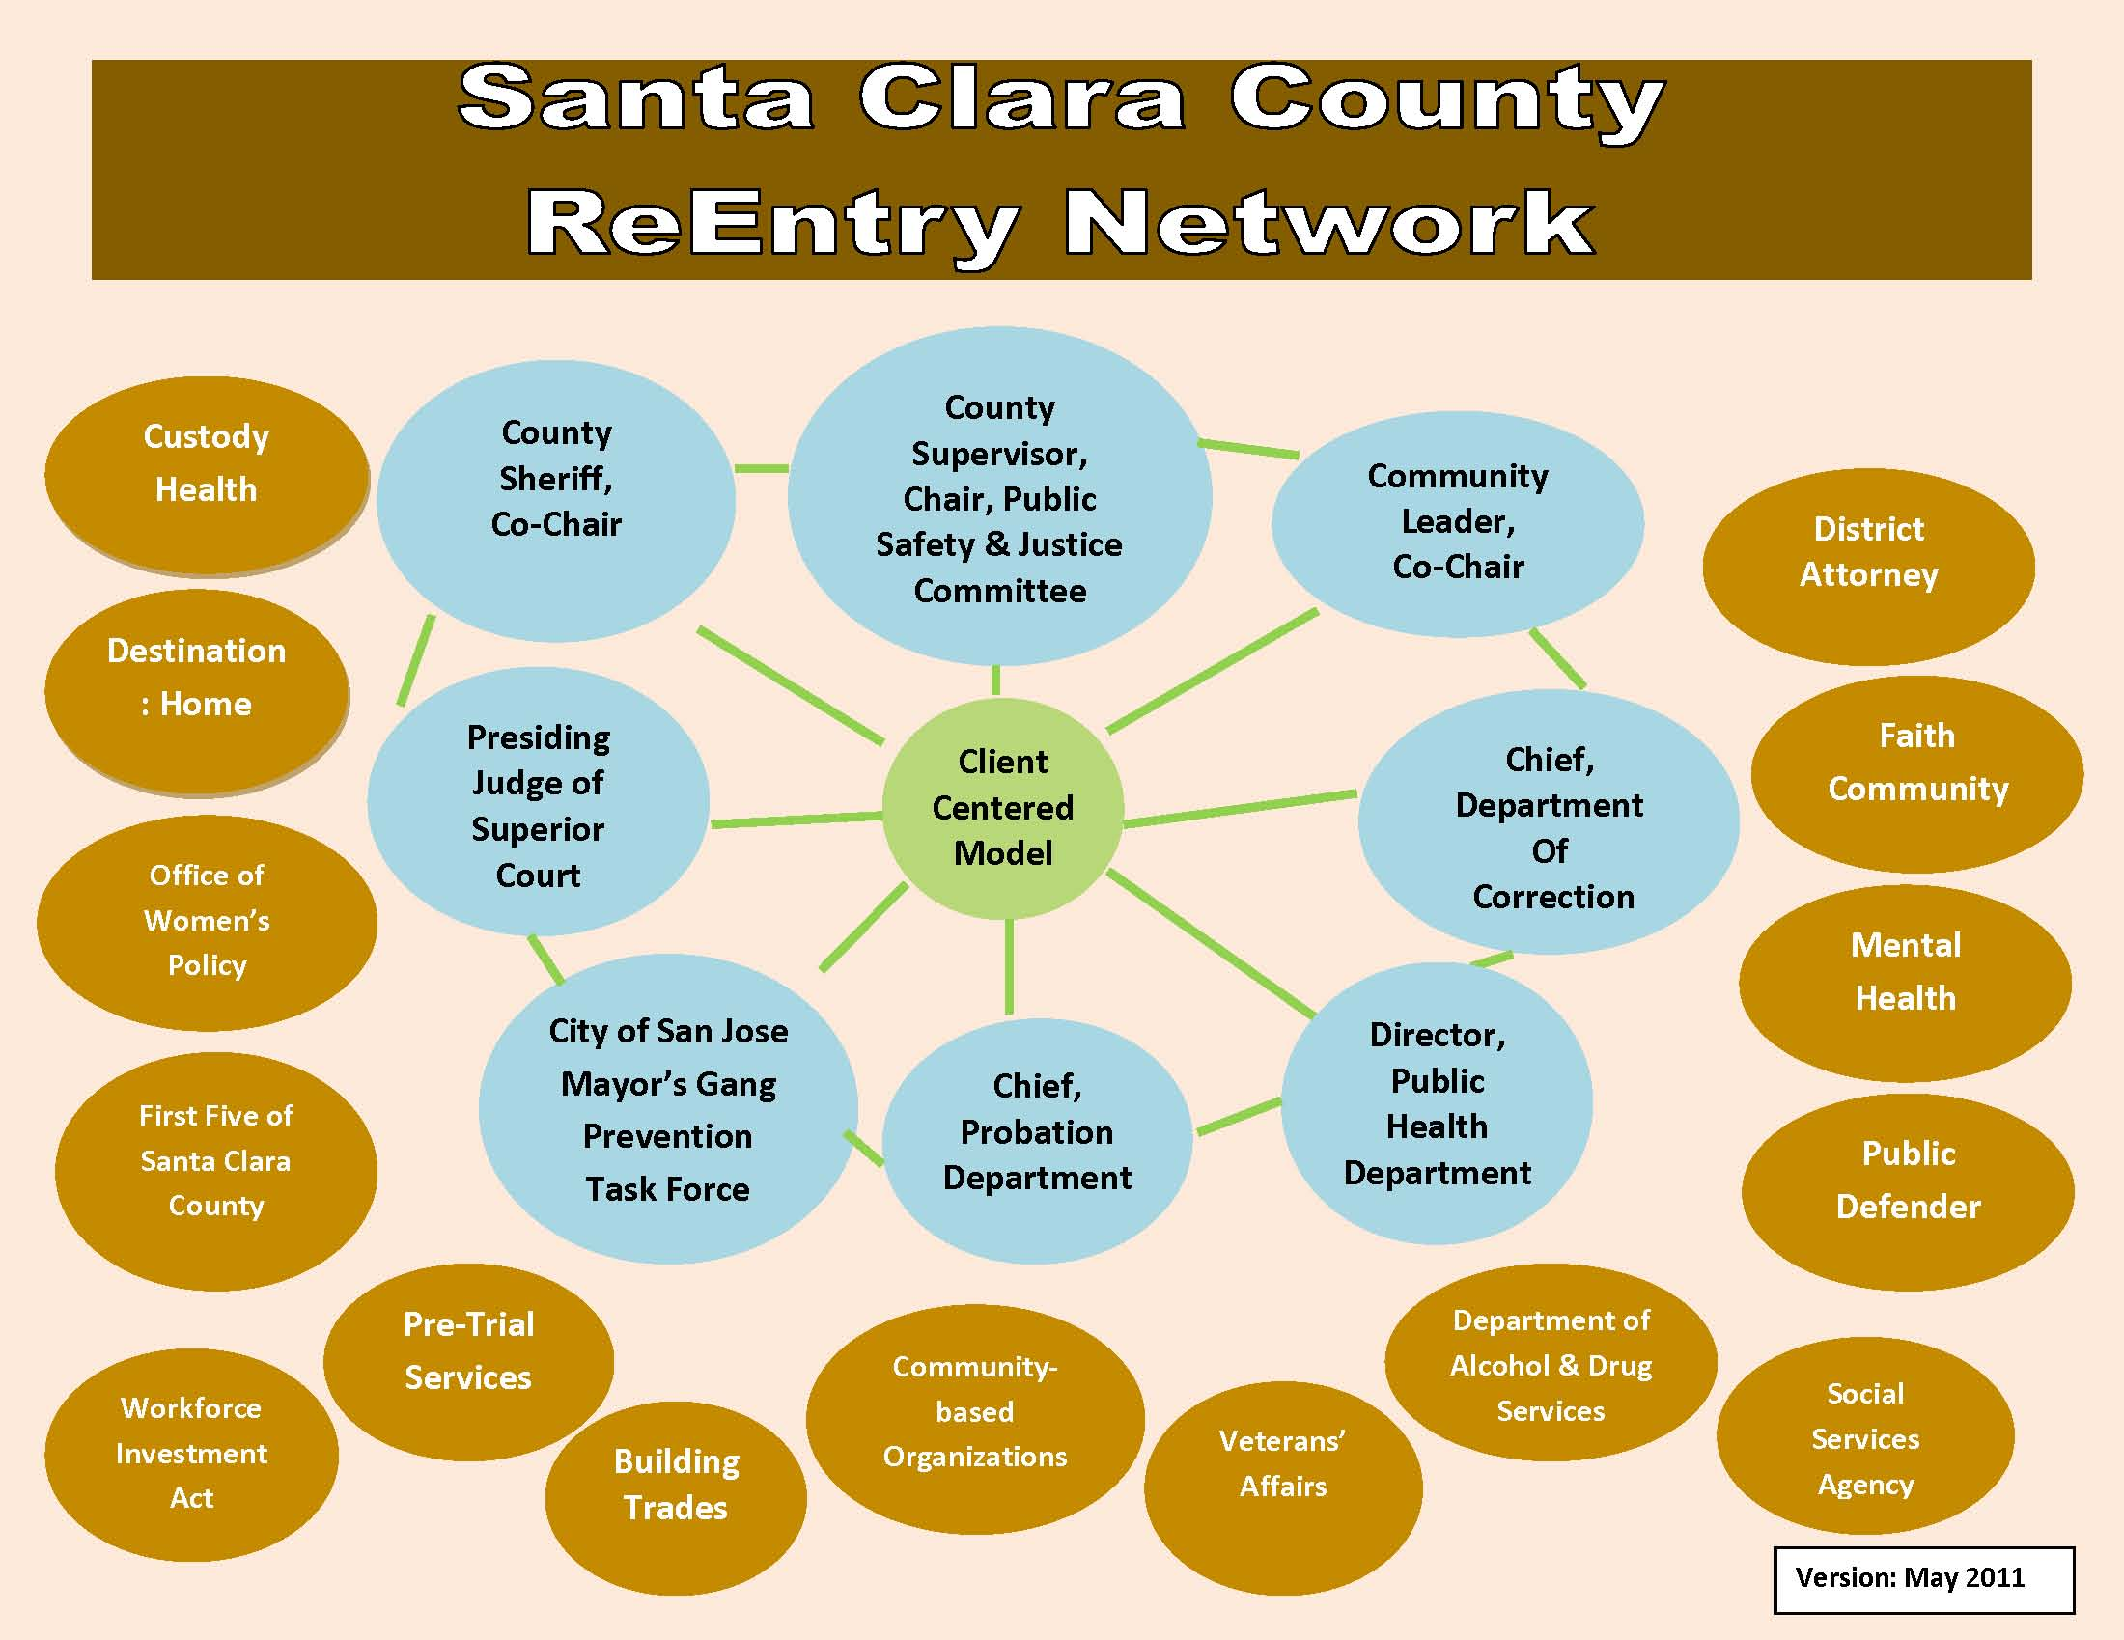
Santa Clara County ReEntry Network
Notes:
One year ago, the San Jose team stood before you all, with this collaborative visual and goal to move into action with a comprehensive re-entry effort for all incarcerated people in Santa Clara County.
I am happy to report that the Board of Supervisors created the Re-Entry Network last June, Chaired by County Supervisor George Shirakawa and co-chaired by Sheriff Laurie Smith and community co-chair and Champion of Change, Cora Tomalinas.
2011 was a monumental year of action, achievements and as is the case with collaboration, lots of meetings!
5

Slide 6
Re-Entry Network of Santa Clara Count: “Support, Services, & Supervision for Success”
RE-ENTRY NETWORK OF SANTA CLARA COUNTY
“SUPPORT, SERVICES, & SUPERVISION FOR SUCCESS”
VISION
To build safer communities and strengthen families
through successful reintegration and reentry
of formerly incarcerated individuals back
into Santa Clara County.
MISSION
To reduce recidivism by using evidence-based practices
in implementing a seamless system
of services, supports, and supervision.
Notes:
First, we developed this vision and mission with a tag line that sums it all up – “Support, Services, & Supervision for Success!”
The Re-Entry Network serves thousands.
Every day, the County houses 3600 men and women in two jail facilities and we detain and rehabilitate 220 youth in our Juvenile Hall and Ranch facility. 60% of these adults and juveniles will return to the City of San Jose while the other 40% will live in the other 14 cities within our jurisdiction.
Last October of new legislation (AB109) was implemented. And, for the last 6 months, a massive restructuring of community supervision and sentencing for certain offenders who used to go to prison or released on parole are now the County Probation and County Jail’s responsibility. Each month, the County is responsible for an addition 100 to 150 new clients being released from prison and we house 400 more in our jails. Local re-entry planning is happening at a perfect time.
6

Slide 7
Implementation of dynamic, validated risk and needs assessment tools to identify criminogenic needs, across juvenile & criminal justice system touch points.
Juvenile Probation: JAIS - Juvenile Assessment & Intervention System (NCCD)
Department of Correction & Adult Probation : CAIS – Correctional Assessment & Intervention System (NCCD)
Office of Pretrial Services: State of Virginia, Pretrial Justice Institute, currently doing validation study
Objective Identification & Seamless Delivery
Notes:
As one of the most diverse counties in Nation with 50% of our residents speaking a language other than English at home, we must be culturally & linguistically competent and most importantly objective in the dynamic between institutions and clients. We value this rich diversity, but, I think you’ll agree, that institutions and systems are slow to adapt to changing demographics which leads to significant challenges especially in public safety and justice. We must adapt, embrace these changes and move forward together.
For Effective Re-entry, we must focus on creating environments and delivering services that are gender-responsive, culturally competent, and trauma-informed!
How do we do this? We start with an objective risk and needs assessment tools that helps us know the clients where they’re at that any point in time from the institutional phase to the transition phase into the community phase.
In 2011, we finally achieved implementation of validated tools across the systems throughout the decision points
in juvenile and adult probation
in adult pretrial which had been using the same tool for 40 years.
And, of course, our Department of Correction is now in contract for its first, validated risk and needs tool scheduled for implementation this spring.
And, please don’t confuse your jail’s housing classification screening tool with a risk & needs tool, they are vastly different. The tool will tell us what the clients needs are for pairing them with right programming, and assisting with the right dosage and duration of treatment which will lead to better outcomes.
7

Slide 8
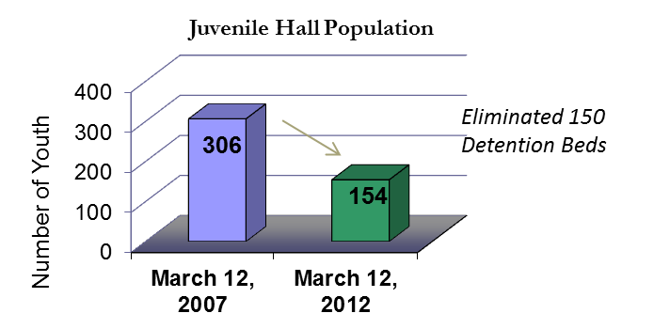
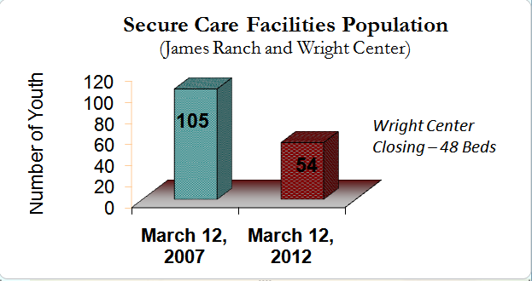
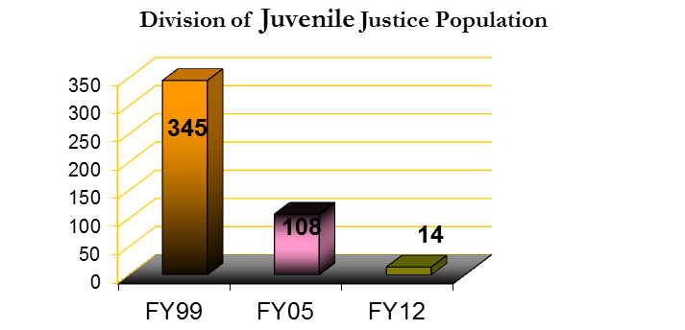
EFFECTIVE RE-ENTRY:
GET YOUR HOUSE IN ORDER!
Notes:
You can do a lot of work in the community but, if your own youth detention and jail facilities are NOT in order, all the work can be undermined. In Santa Clara County, we have been taking a hard look at ourselves for over 10 years on making sure the right kids are kept out of detention in the first place. With the outstanding leadership of Sheila Mitchell, our Chief Probation Officer, we have achieved results and we are REALLY proud of our current trends.
As you can see, we’ve have cut our Juvenile Hall pop in half since 2007 and eliminated 150 detention beds.
Significantly reduced our ranch population and just closed 48 beds down last month.
Over the last decade, we have drastically reduced the # of youth sent to California’s DJJ or old Youth Authority. Now, we only send sex offenders who we have no local placement options for at this time.
8

Slide 9
THE WORK
Implementation of Seven Challenges Program (SAMSHA) for seamless transition of substance abuse services in custody to community
GRID: Guiding Responses Informed Decisions
Expansion of alternative to incarceration:
    The EDGE – Education, rehabilitation, CBT program in the community with gang affiliations, history of delinquency and substance abuse
    Electronic Monitoring: Improved consistency, set guidelines for response strategies RESULT: 7% increase in success rate to 74%
Notes:
GRID – developed by Probation Officers in assistance with the Burns Institute, this creates buy-in by the staff to believe in the work of objectivity and responsively.
EDGE– Encouraging Diversity Growth Education
The 6 to 9 month program was developed by Probation staff in partnership with the County Office of Education (COE). The EDGE serves up to 40 youth at a time who are between the ages of 15-18 with numerous criminogenic factors including gang affiliation, substance abuse and significant histories of delinquent behavior. program with its focus on cognitive restructuring, academic achievement, and positive peer support is rooted in evidence based practices and emphasizes pro social thinking.
EMP:170 youth monthly, 900 youth annually
Program failures are no longer the majority of the Juvenile Hall and Ranch populations.
9

Slide 10
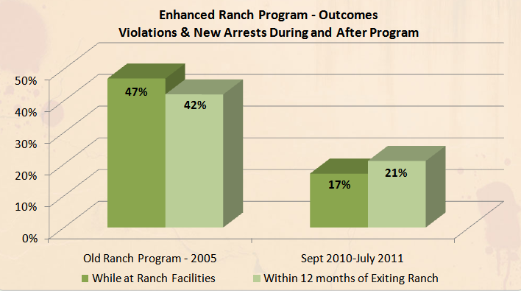
RESULTS: 63% reduction in program violations 50% reduction in new arrests, one year after exit!
Notes:
10
Our deepest-end kids that we keep locally now are in the Enhanced Ranch Program – this is our where juvenile re-entry is really working for us. Instead of sending our placement failures to the California Youth Authority or committing them to Juvenile Hall, we utilize the Ranch.
In 2005, the Board of Supervisors invested heavily (during budget cuts) in a complete rehabbing of our local ranch program from the physical layout, the training of employees, the curriculum and structure of the day – it is a different program. Out went the dormitory or prison style living areas to a more home-like setting with couches, beds, living rooms. – Essentially, a therapeutic model based on the Missouri State model, tailored for Santa Clara County kids, designed by our Probation Department.
With this slide, you’ll see the results. Under the old program, 47% of our kids violated during the program and 42% of our kids were failing one year with exiting the program. We stopped and asked ourselves, were the kids failing or was the program failing the kids? After the investment in the new program, and by late last year, we’ve seen positive and significant reductions in program violations and a 50% reduction in new arrests one year after exiting the program!
Now, 79% of our kids are succeeding one year after exiting the program.
But, with an eye towards continuous improvement, we know where we can do better and are focused on how to seek success for the whole family when their child returns home. We are currently an OJJDP demonstration site seeking to improve the outcomes specifically for our Latino and African-american youth returning home from the ranch.
With 35% of our County as Latino BUT, 80% of those in our youth facilities are youth of color and mostly Latinos, we have a troubling, stubborn, long-held challenge. While our numbers decrease, the disproportionate rates persist. And, we will persist to turn this around.
10

Slide 11
GOOD TRENDS!
WRAPAROUND SERVICES
“the family is vital to the treatment process”
family viewed as “expert, staff serve as facilitators”
Notes:
11
Back to the good news, Probation is implementing WRAP services for a family-focused, no fail approach for these youth.
In true re-entry, we have to get the system out of being the answer to our families struggles.
11

Slide 12
Comprehensive Adult Re-Entry
Factors | Variable | Percent Recidivated
Age at arrest | 24 or younger | 58%
Gang involvement | Reported being in a gang at arrest | 75%
Drug offense | Charged with “any” drug offense | 71%
Prior arrests | 1 or more 6 or more | 57% 77%
Prior probation violations | 1-2 3 or more | 71% 85%
Not involved in treatment | Re-arrests (6-24 mo.) Re-convictions (6-24 mo.) Re-incarcerations (6-24 mo.) | 34%-64% 24%-42% 24%-59%
Notes:
12
Work on the juvenile side is our most important work for the community’s health and for the future of our Latino and African-american youth. We are taking all that we have learned on the juvenile side and looking to replicate it on the adult side where it makes sense.
Last year, the County was awarded a $50k planning grant for comprehensive adult re-entry at the same time, AB 109 was signed into law. And, last month, we received our first ever Recidivism Study, with some of our rates listed here, which will set our baseline for future results.
This puts the pressure on us to figure out a way to deliver on the adult side. Together with the City of San Jose, our community partners, our faith community and law enforcement, the County of Santa Clara is always excited and ready for the challenges ahead and we thank the National Forum for your encouragement and focus on this issue that has the ability to transform families, our neighborhoods, and most importantly our kids.
12

Slide 13
Moving Forward
Moving Forward
Forging a working Private/ Public Partnership
Increasing efficiencies on the Task Force through partnerships
Increase Funding Development
Notes:
13
Moving Forward
Forging a working Private/ Public Partnership
Adult Demonstration Grant
13

